Slide 1
Capstone project interim report - Group 2
Topic : Used Car sale price prediction.
Anusman kumar
Sumanth ER
Elumalai
Sravani B

Slide 2
Introduction to the Data set and Business objective :
BUSINESS OBJECTIVE
Pre used cars have a huge market base as many consider to buy Used Cars instead of buying of new one due to it’s feasibility and better investment.
The main reason for this huge market is that the price of car reduces by 30%.
There are many frauds in the market selling wrong vehicle but also they could mislead to wrong price.
So, here we used this following dataset to Predict the price of any used car.
PROBLEM STATEMENT
The used car market suffers from inconsistent data quality and a lack of predictive models for fair pricing, hindering informed decision-making.
This project aims to leverage multiple machine learning models to enhance data quality, predict fair market values accurately, and provide user-friendly interfaces for analysis.
By integrating various algorithms, the solution seeks to offer comprehensive insights and facilitate efficient decision-making in the used car industry.

Slide 3
Collect the "Used Cars Dataset" from various sources such as online platforms, dealership records, or publicly available datasets.
Ensure that the dataset contains relevant information such as car attributes (e.g., make, model, year, mileage), pricing data, and condition descriptions.
Perform EDA to gain insights into the distribution and relationships of car attributes.
Visualize key statistics and trends using charts, histograms, scatter plots, and other exploratory techniques.
Identify patterns, correlations, and potential outliers in the data.
Data Collection:
Data Cleaning :
EDA:
Data Preprocessing:
Clean the collected data to address issues such as missing values, outliers, and inconsistencies.
Standardize formats, handle null values, and remove duplicate entries to ensure data quality.
Preprocess the data to prepare it for model building.
Perform tasks such as feature scaling, normalization, encoding categorical variables, and handling imbalanced classes.
Split the dataset into training, validation, and test sets.

Slide 4
Evaluate the performance of trained models using appropriate evaluation metrics (e.g., Mean Absolute Error for regression, F1-score for classification).
Compare the performance of different models to identify the best-performing ones.
Model Building:
Model Evaluation Technique:
Deriving the Business Metrics and Business Insights:
Select appropriate machine learning algorithms based on the problem type and data characteristics (e.g., regression for price prediction, classification for condition assessment).
Train multiple models using the training dataset and tune hyperparameters to optimize performance.
Use the trained models to derive business metrics such as predicted car prices, predicted car conditions, or customer segmentation.
Interpret the model results to extract actionable insights and make informed business decisions.
Communicate findings and recommendations to stakeholders through reports, dashboards, or presentations

Slide 5
In the coming days, we will focus on enhancing the predictive power of our models by engineering new features and selecting the most relevant ones from the "Used Cars Dataset." This step will help improve the accuracy and robustness of our machine learning models.
Next, we will explore Linear Regression models with penalty terms such as Lasso (L1 regularization) and Ridge (L2 regularization). These techniques help prevent overfitting and improve the generalization performance of our models.
Feature Engineering & Feature Selection
NLP on Description Column
Linear Regression
Gradient Descent:
We plan to leverage Natural Language Processing (NLP) techniques to extract valuable information from the description column of the dataset. By analyzing textual descriptions, we aim to capture additional insights that can enhance our predictive models.
Gradient Descent optimization algorithms will be employed to efficiently train our machine learning models. By iteratively updating model parameters to minimize the loss function, we aim to find optimal solutions effectively.

Slide 6
Decision Tree algorithms will be investigated for their ability to capture complex non-linear relationships within the dataset. We will explore techniques such as pruning and ensemble methods to improve model performance and interpretability.
Decision Tree:
XGBoost:
XGBoost, an efficient and scalable gradient boosting library, will be utilized to build powerful regression models. By optimizing model parameters and leveraging parallel computation, we aim to achieve state-of-the-art performance.

Slide 7
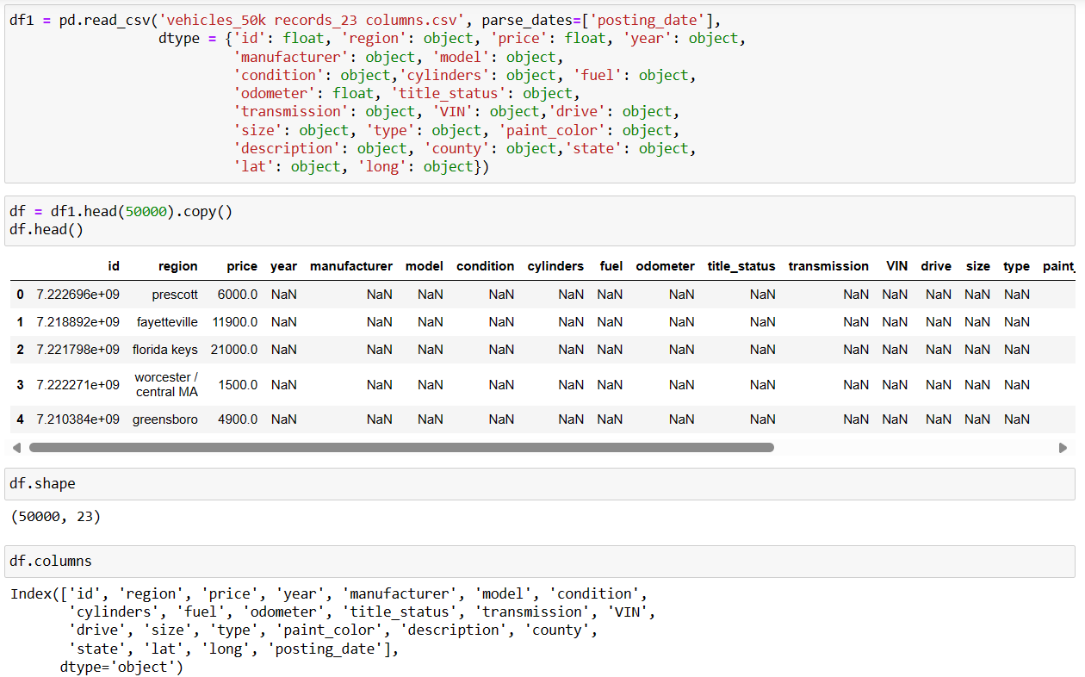
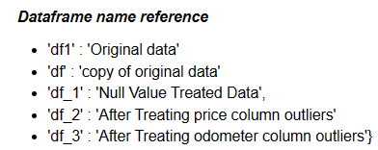
Data Collection:
Data was collected from Kaggle
Data is related to car sales from a website named Craigslist.org
There are 50k records and 23 columns
21 - Categorical Column
2 - Numeric Columns

Slide 8
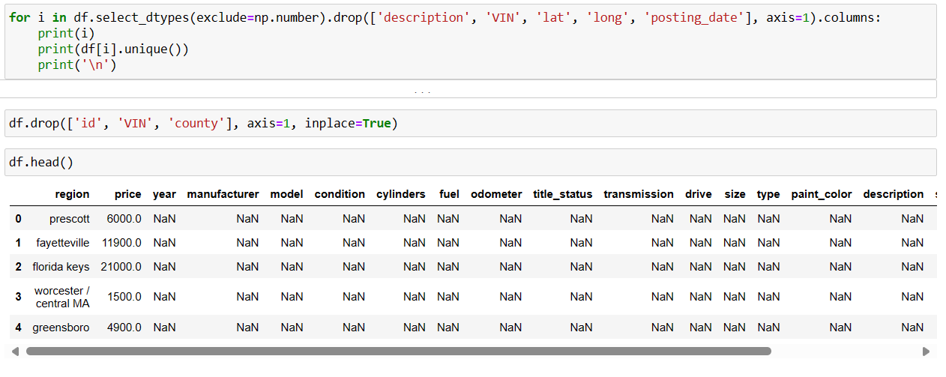
Data Cleaning :
1. Find unique values in each category and correct misspelled or incorrect sub-categories
2. Drop columns which does not hold significance to the target variable
Result: Number of Columns 23 -> 19

Slide 9
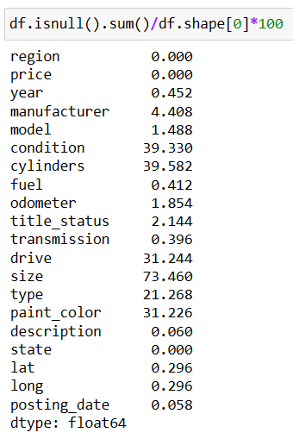
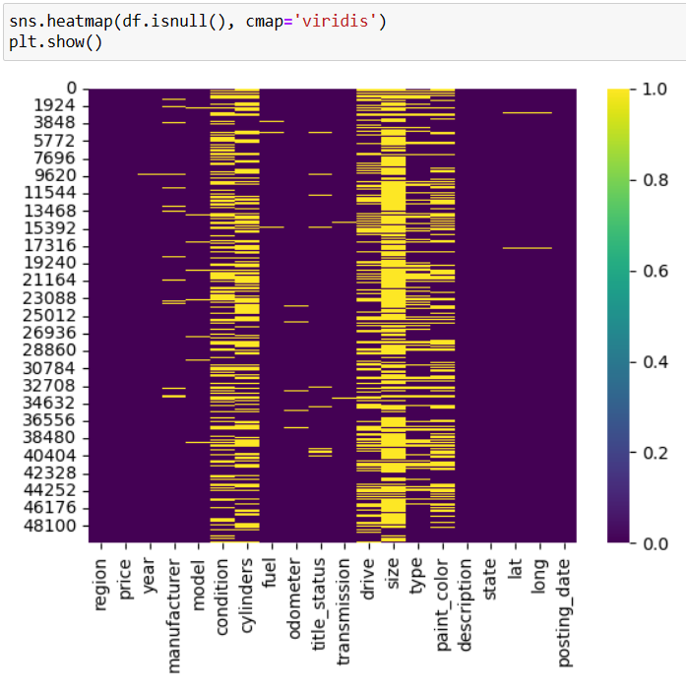
Data Cleaning (Null Value Treatment):
1. Identify null values in each column
2. Drop columns if null values are more than 70% (Because such columns induces more bias into the data)
3. Drop records having more than 5 null values
4. Impute int columns using KNN imputer
5. Categorical columns are imputed with bfill to reduce bias
Result:
Number of Columns 19 → 18
Number of Records 50K → 49,345

Slide 10
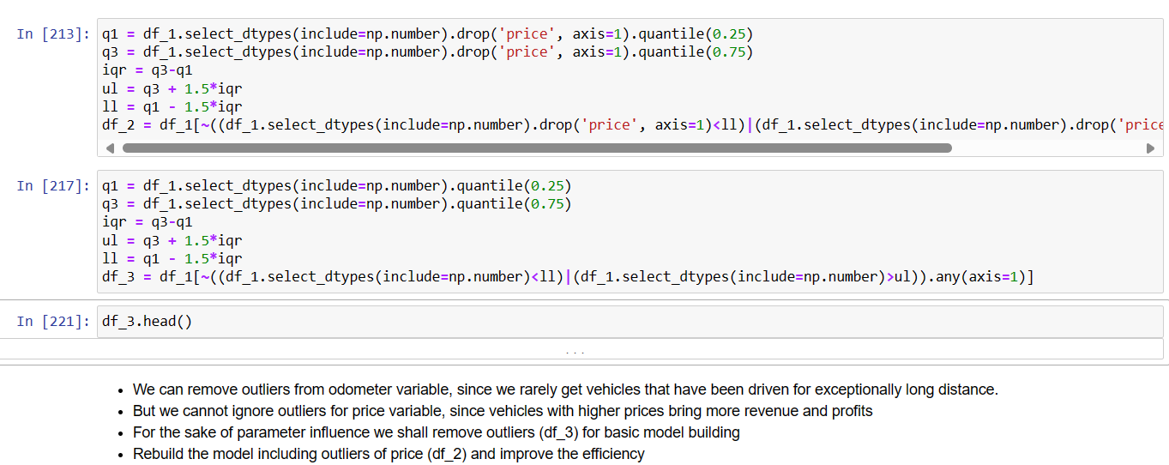
Data Cleaning (Outlier Treatment) :
1. Find unique values in each category and correct misspelled or incorrect sub-categories
2. Drop columns which does not hold significance to the target variable
Result: Number of Columns 23 -> 19

Slide 11
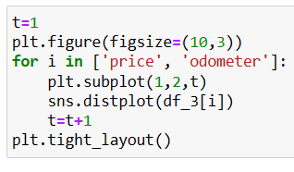
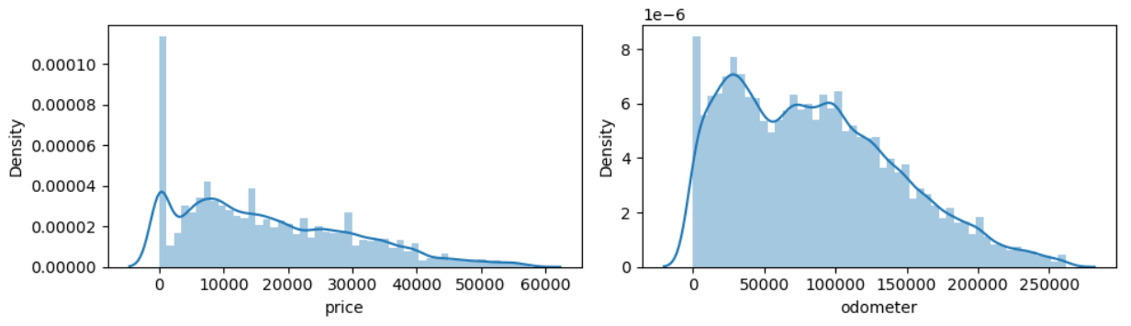
Exploratory Data Analysis (EDA) (UniVariate – Numeric):
Univariate analysis for numeric columns was done to check the distribution of values
Also provides information on outliers, if any

Slide 12
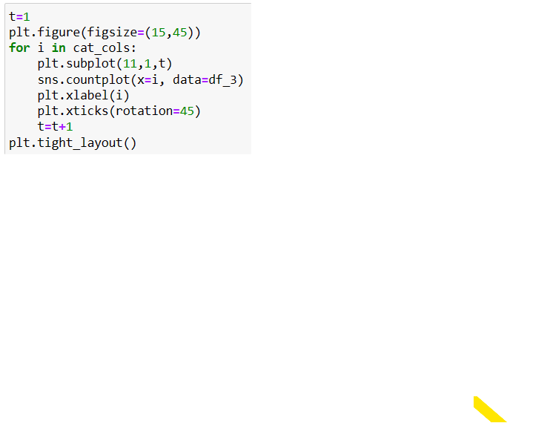
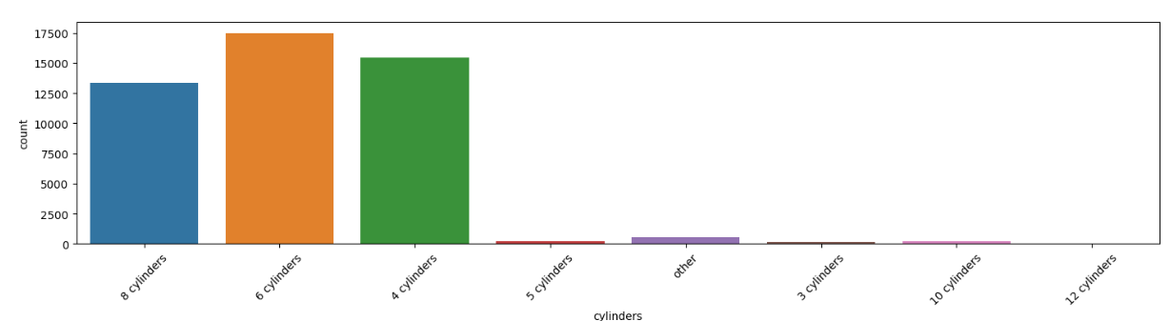
Exploratory Data Analysis (EDA) (UniVariate – Categorical):
Univariate analysis for categorical columns was done to check the distribution of values
Sales of 6, 4 and 8 cylinders engine cars are very high compared to 5, 3, 10 and 12 cylinder engines.

Slide 13
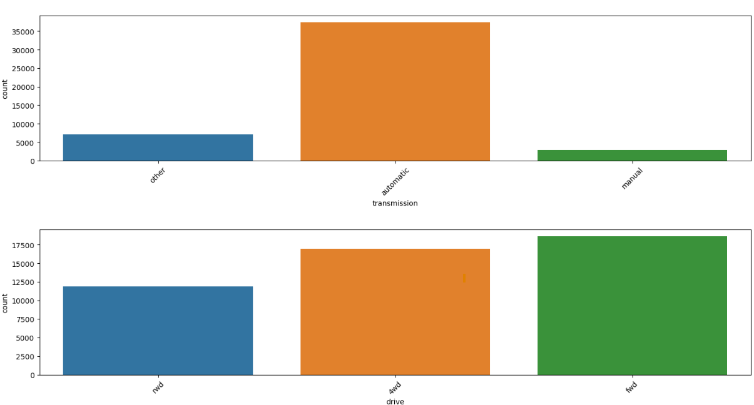
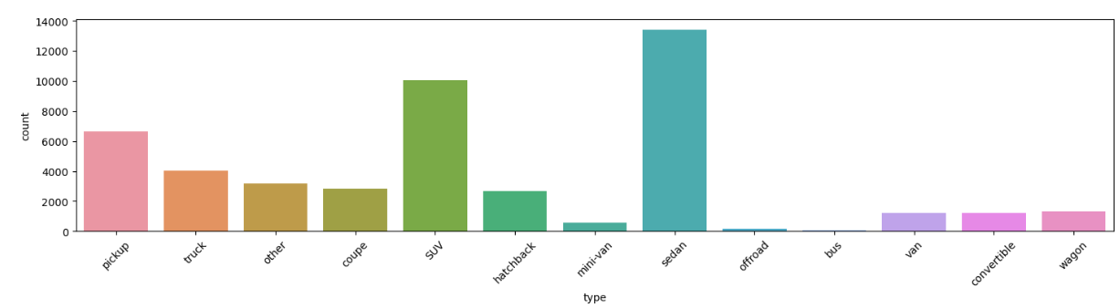
Exploratory Data Analysis (EDA) (UniVariate – Categorical):

Slide 14
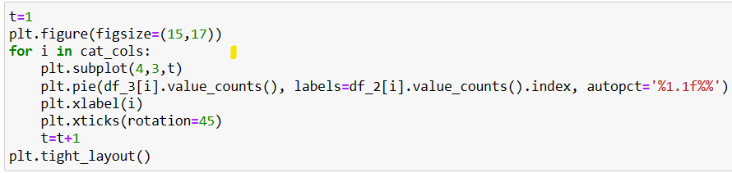
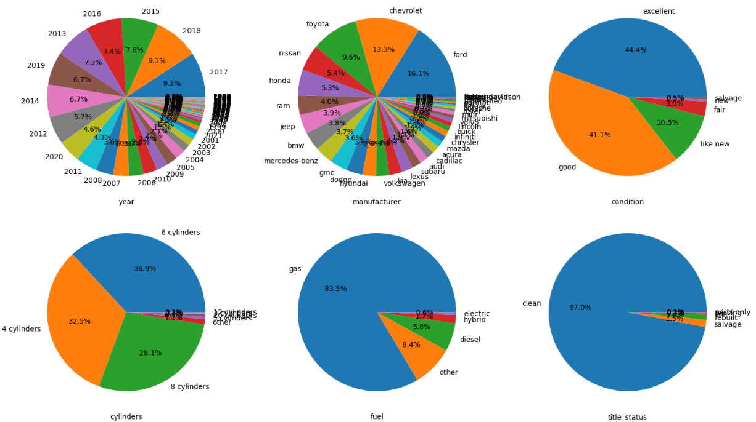
Exploratory Data Analysis (EDA) (UniVariate – Categorical):

Slide 15
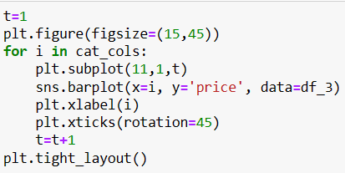
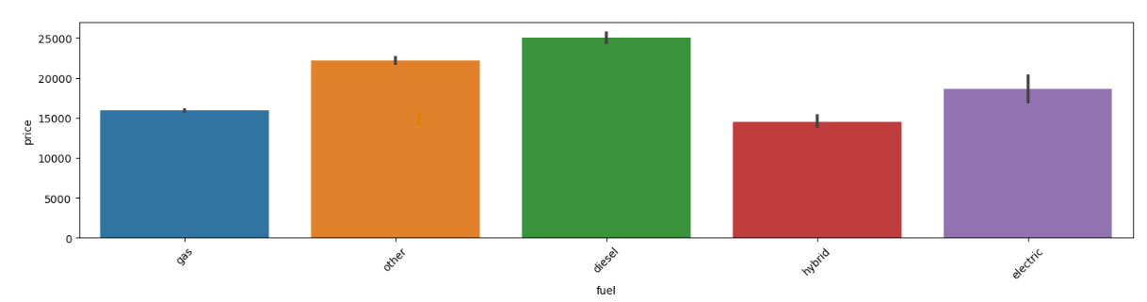
Exploratory Data Analysis (EDA) (BiVariate – Categorical):
Bivariate analysis for categorical columns was done to check the distribution of values
Diesel is priced high whereas hybrid is less priced. This is because diesel engines are more reliable whereas hybrids needs regular maintenance.
Also provides information on outliers, if any

Slide 16
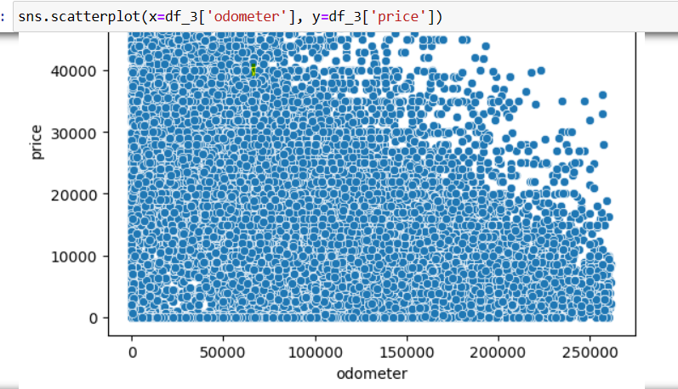
Exploratory Data Analysis (EDA) (BiVariate – Numerical):
Bivariate analysis for numeric columns was done to check the distribution of values
Also provides information on outliers, if any
In this graph Price vs Odometer, we can see that less driven cars are priced high.

Slide 17
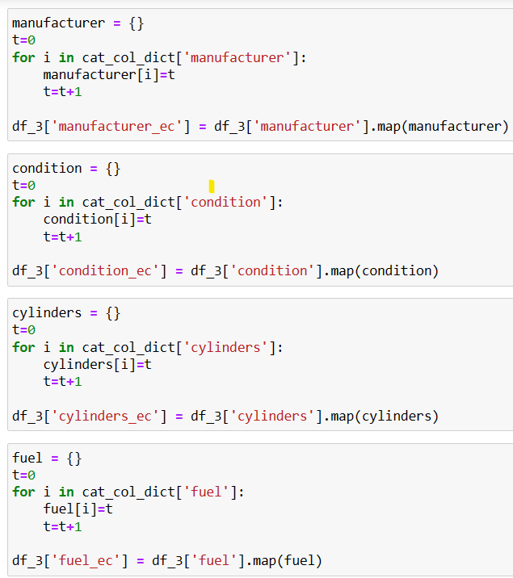
Exploratory Data Analysis (EDA) (Encoding):
Numeric Transformation: Ordinal encoding converts categorical variables into numerical representations (e.g., manufacturer, condition).
Sequential Value Assignment: Each category within a variable is assigned a unique numerical value starting from 0 (e.g., cylinders, fuel type).
No Inherent Hierarchy: Ordinal encoding doesn't imply hierarchy among categories (e.g., manufacturer, fuel type).
Suitability for Ordinal Data: Effective for variables with predefined order (e.g., condition, title status).
Enhanced Model Performance: Contributes to improved predictive accuracy in tasks such as estimating used car prices.

Slide 18
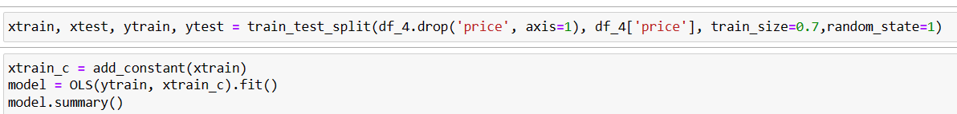
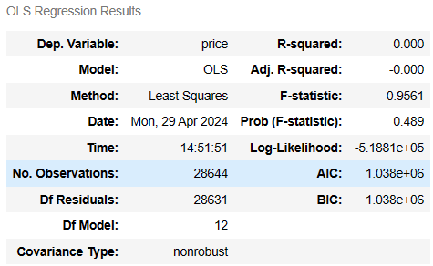
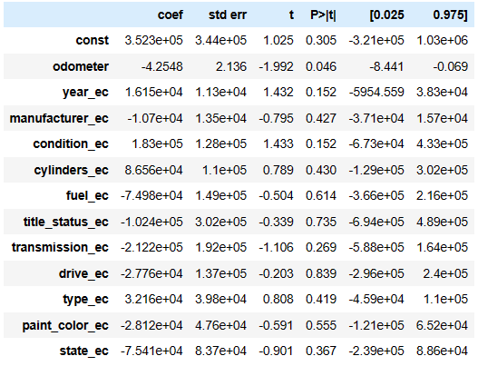
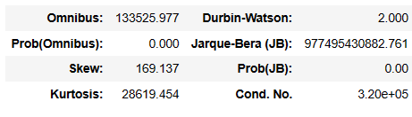
Basic Model Build: before removing outliers
A Basic model was built to check the performance and identify significant features
Since R-Squared is very low, we first treat the outlier and check the R-Square value.

Slide 19
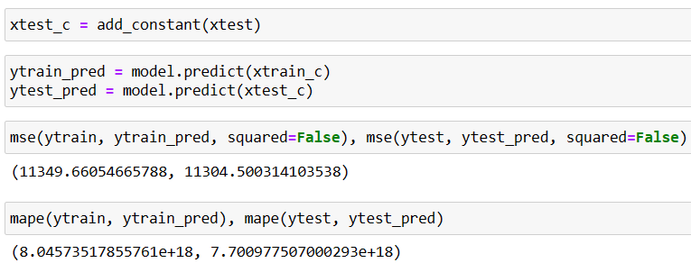
Basic Model Build (Model Evaluation):
We have a high MSE value (around 60% the mean value)
Though R-Squared (Explained Variance) is less but the MAPE value is good
We need to improve the model performance by chaining
Encoding
Transformation
Scaling & Imputation
Model selection

Slide 20
Metric Value Movement Across Models
Increase in R2 Score, decrease in MSE & MAPE has been improved by adapting various data treatment techniques and increasing model complexity.

Slide 21
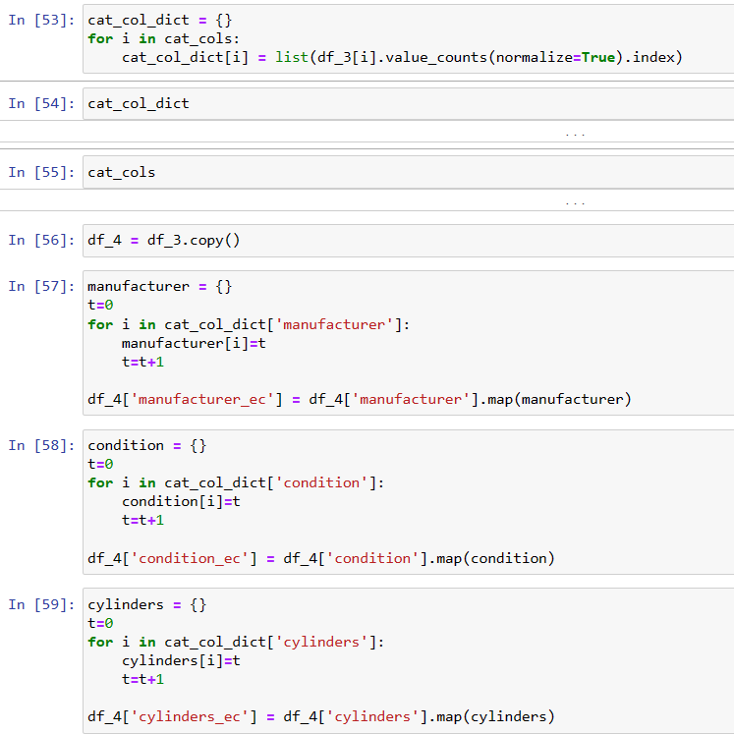
Encoding

Slide 22
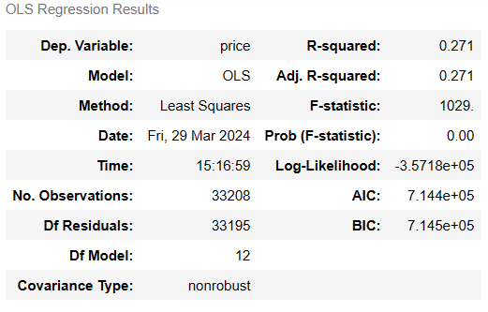
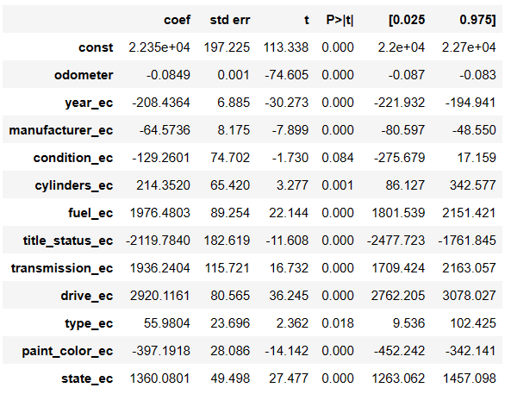
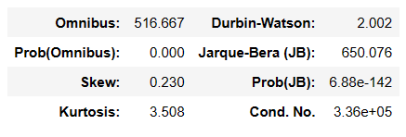
Basic Model Build: (after removing one-sided outliers)
Inference:-
Since R-Squared is very low, we need to further enhance model performance by treating multicollinearity.
removing outliers from price which are less than the lower limit and outliers from odometer greater than the upper limit.
removing outliers from odometer variable, since vehicles driven for exceptionally long distance are rare.
outliers for price variable can’t be ignored, vehicles with higher prices bring more revenue and profits.
For the sake of parameter influence we shall remove outliers (df_3) for basic model building
Rebuild the model including outliers of price (df_2) and improve the efficiency

Slide 23
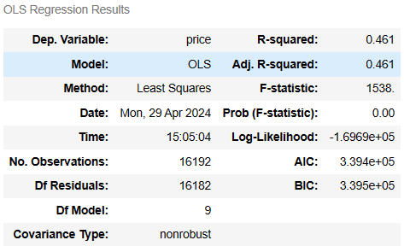
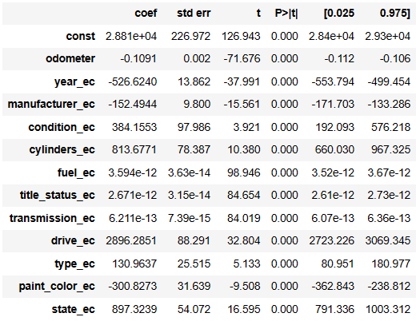
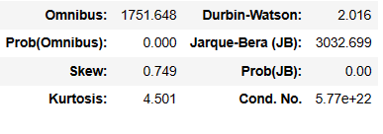
Basic Model Build: (after removing all outliers)
Since R-Squared is very low, we need to further enhance model performance by treating multicollinearity.
High VIF indicating variance of the coefficient estimate is greatly inflated by multicollinearity.
independent variable is highly correlated with other independent variables in the model.

Slide 24
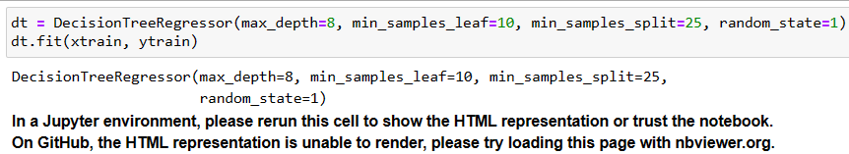
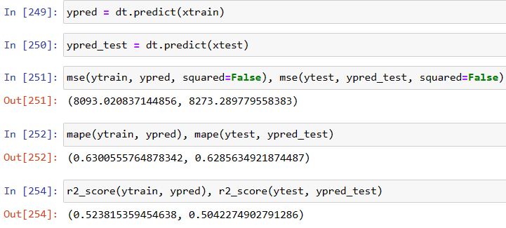
DecisionTreeRegressor :-Before implementing NLP
Decision Tree Regressor :-
a non-parametric, interpretable model is used for regression tasks for building a tree structure based on feature thresholds in this case Car_Type to predict the target variable.
Each internal node represented a decision based on a feature, and each leaf node represented the predicted value.
In this case some premium car which is older than the economy car but could be priced same. So decision tree helps us making nodes segment wise.DecisionTree are more robust to outliers.

Slide 25
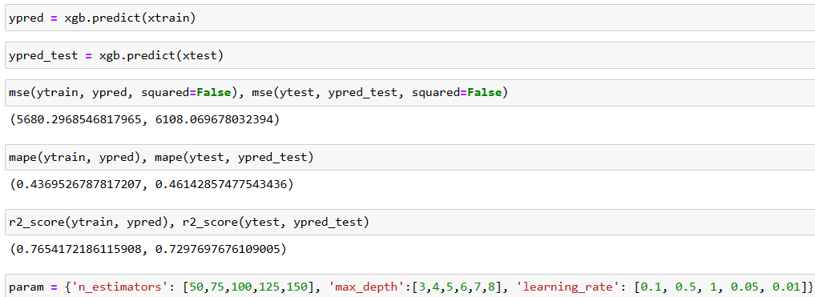
XGB-Regressor : - Before implementing NLP
XGBoost (Extreme Gradient Boosting)
Is well-suited for our used car dataset. It efficiently handled complex relationships between car features (like year, mileage, condition, etc.) and sales prices.
Ability to handle missing data and provide feature importance scores,
XGBoost can effectively predict car sales prices based on the provided features, offering accurate insights for our regression task.
XGBoost outperforms Decision Trees :-
Improve accuracy,
handling non-linear relationships
providing more reliable feature importance scores
more computationally efficient.
XGBoost's boosting key properties in this car dataset :-
Enabling algorithm to iteratively improve predictions.
Focusing on areas where previous models struggled.
Effectively capturing the complex relationships between car features and sales prices.
Boosts predictive accuracy.

Slide 26
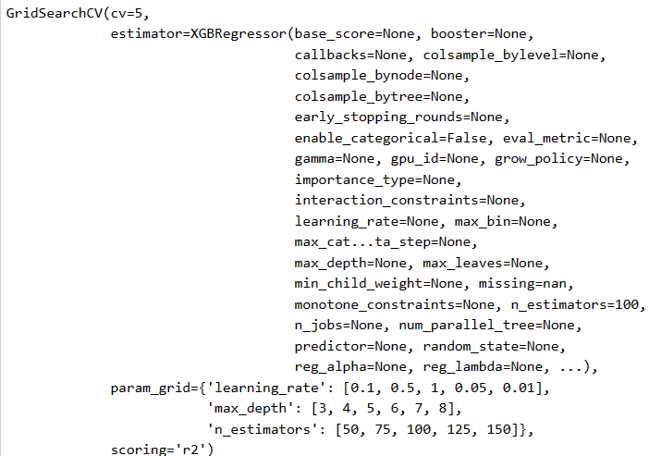
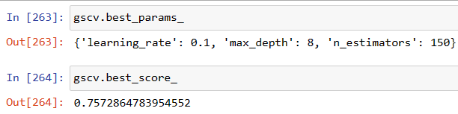
Grid-Search_CV
GridSearchCV :-
Systematically searches through a predefined grid of hyperparameters.
Evaluates model performance using cross-validation.
Identify the optimal combination that yields for best results.
GridSearchCV for this dataset :-
Helps fine-tune XGBoost's parameters
Learning rate
Maximum tree depth regularization parameters
Enhancing the model's predictive accuracy
Robustness.
This ensures that XGBoost is optimized for our specific regression task, improving its performance in estimating used car prices effectively.

Slide 27
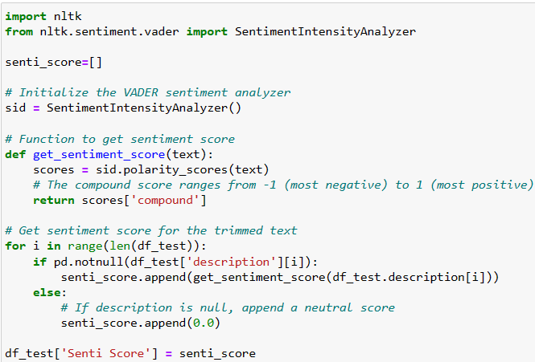
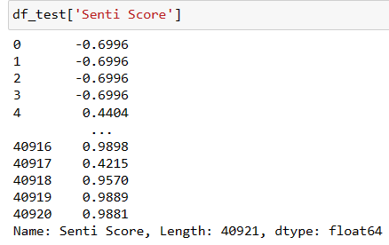
NLP :-
NLP to car dataset :-
Learned extracting insights from textual descriptions.
Enriching our feature set with additional context.
This iterative process has enhanced our skills in data analysis and predictive modeling.
Inference
No significant improvements in predictive performance,
gained valuable experience in feature engineering, model evaluation, and domain understanding.

Slide 28
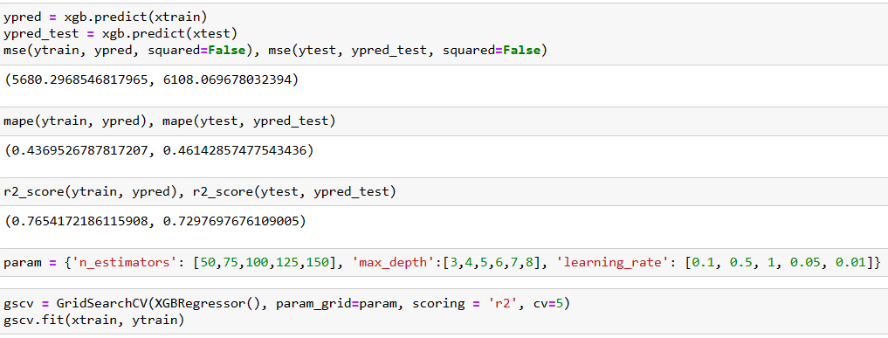
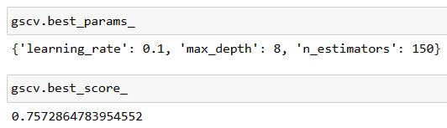
XGB-Regressor : - After implementing NLP
The lack of improvement in scores suggests that the textual information is not sufficiently informative for predicting used car prices.
Despite the lack of improvement with NLP features, we have finalized XGBoost as our best model.
We've achieved satisfactory results in terms of R-square, MSE, and MAPE values, indicating that XGBoost effectively captures the underlying.

Slide 29
Over View :
Summary
Built a Robust predictive model for sales price for used cars.
Concluded essential features like odometer, condition and cylinders.
Using ML techniques found more critical features like manufacturer, model, fuel type.
Significance improvement in predictive model performance due to critical features addition.
Experimented xgboost , DecisionTree regressor , NLP to extract and enhance predictive accuracy.
Challenges:
Data cleaning
Data encoding
Binning
Highly skewed data
Very complex patterns.
Feature relevance
Model selection.
Learning outcomes:-
Intricacies of predictive modelling
Feature engineering.
Domain specific knowledge.
Iteratively adaptive strategies for optimal performance.
Way forward :-
Collecting more informative features such as mileage , how many times the car is pre –owned for better feature relevance.
Try other types of encoding and transformation techniques.
Inference :-
This dataset consists of inconsistent data quality and lack predictive modeling for fare pricing.
of all the models that are build by the feature engineering XGB regressor is better in predicting fare price.

Slide 30
Thank You

